Slide 1
A birds-eye view of the course
Code
Theory
Reality

Slide 2
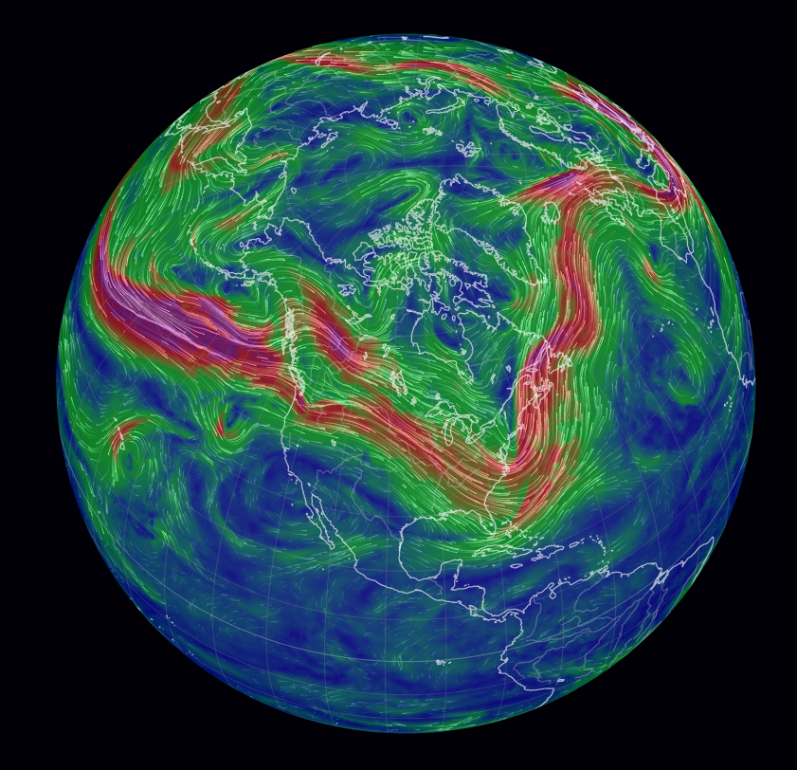
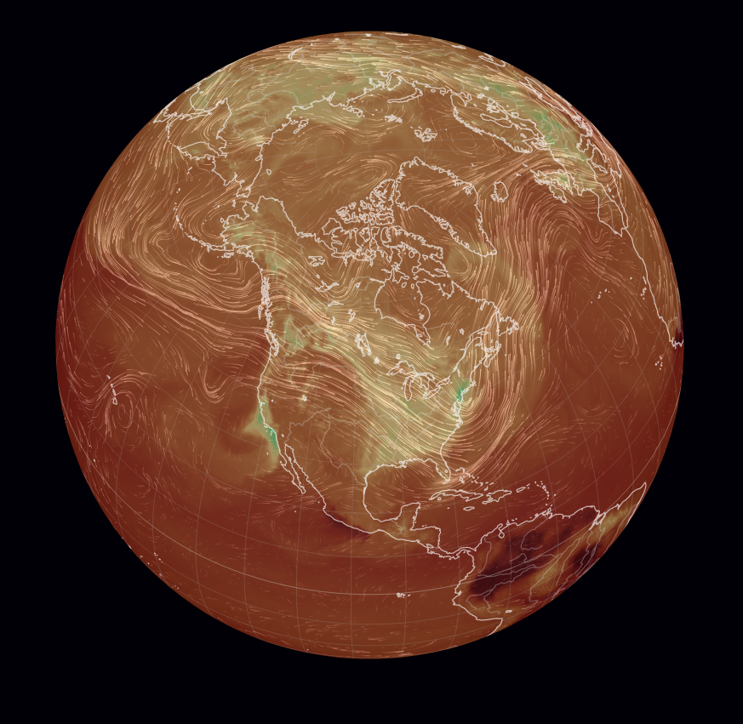
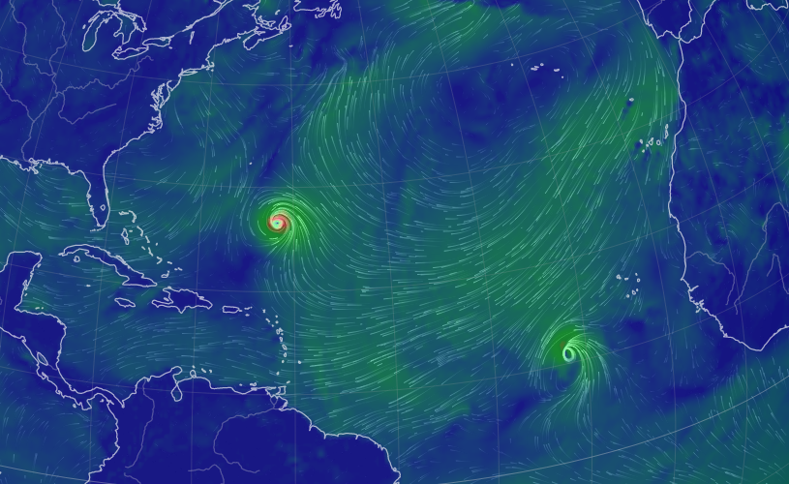
Week 1 - From weather to climate
Synoptic systems
Upper-atmosphere winds
CO₂ and other pollutants

Slide 3
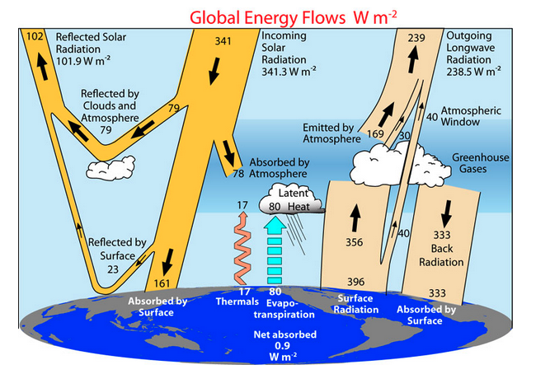
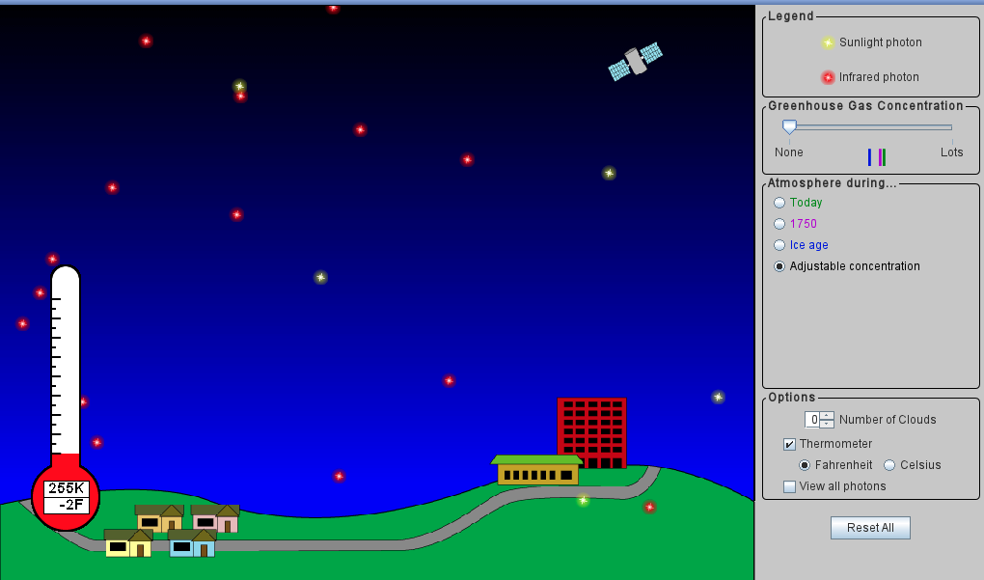
Week 2 - Radiative balance
Key lesson learned: If albedo drops by just 0.01 (say, from 0.3 to 0.29), expect temperature increase of +1 ºC.

Slide 4
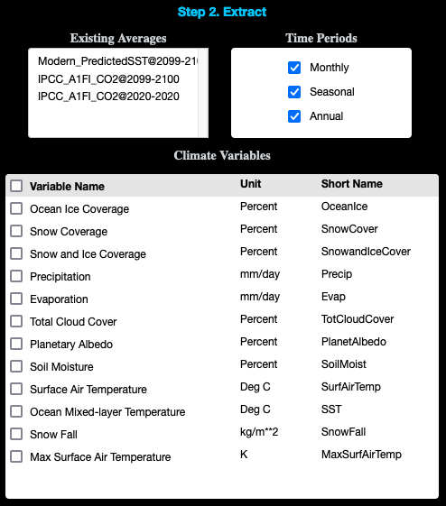
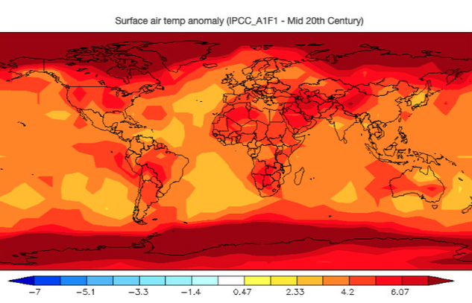
Weeks 3 & 4 - EzGCMs

Slide 5
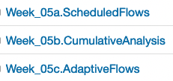
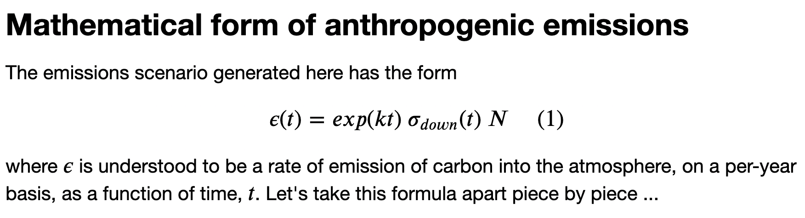
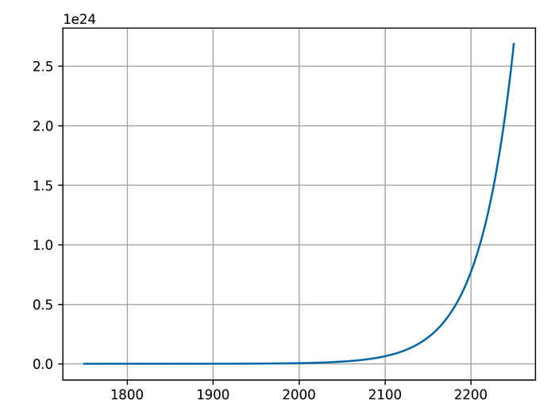
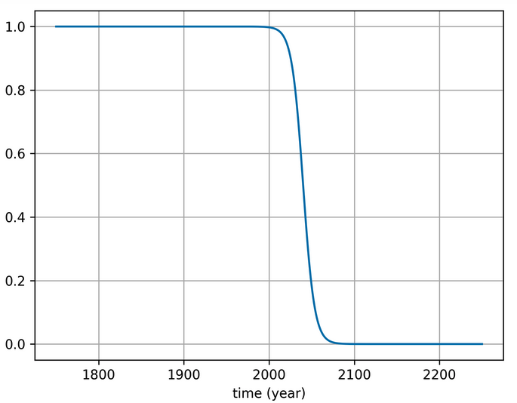
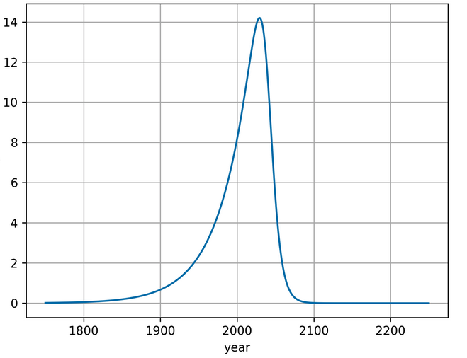
Week 5 - Scheduled and adaptive flows

Slide 6
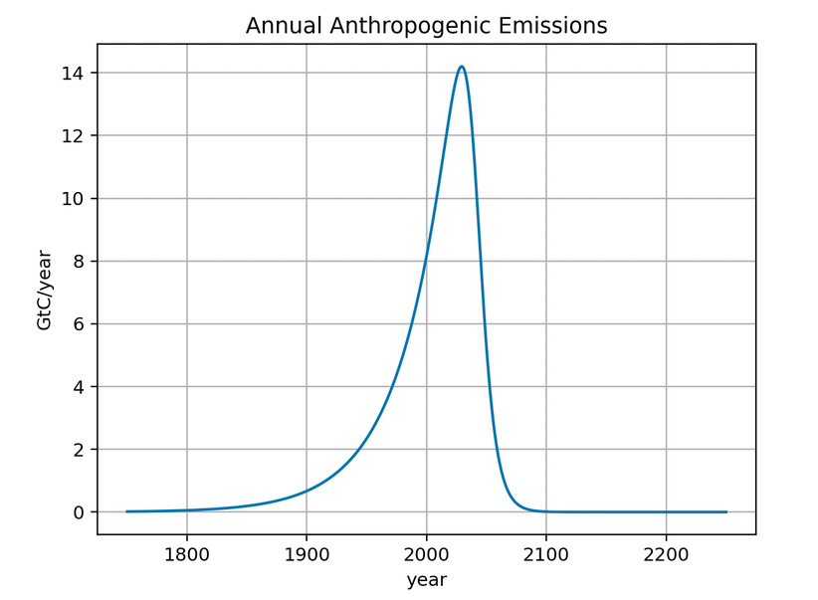
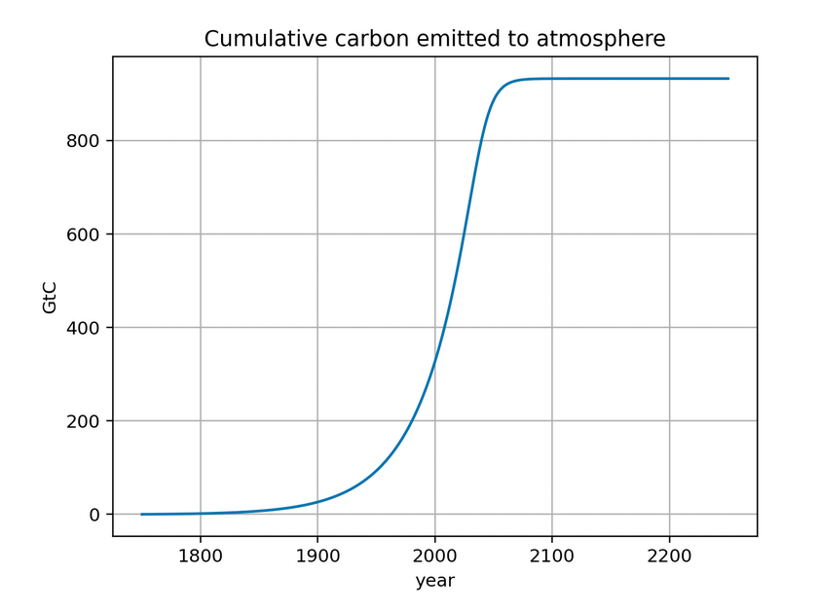
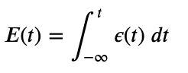
Week 5 - Scheduled and adaptive flows

Slide 7
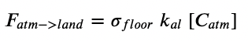
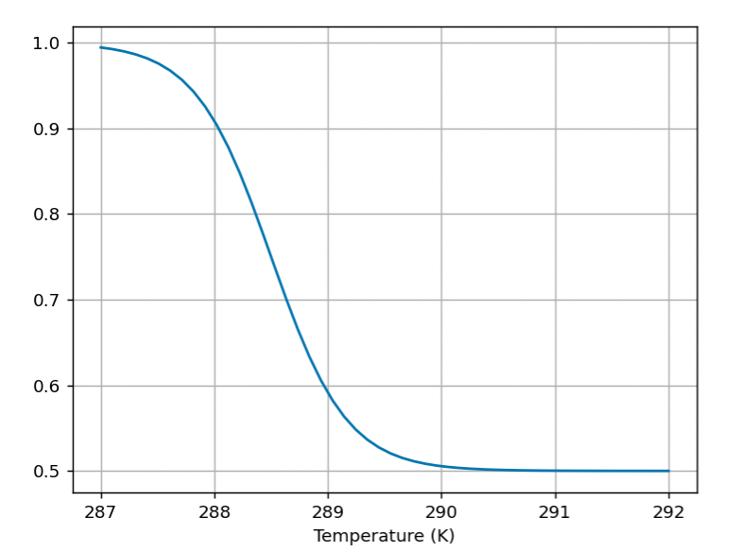
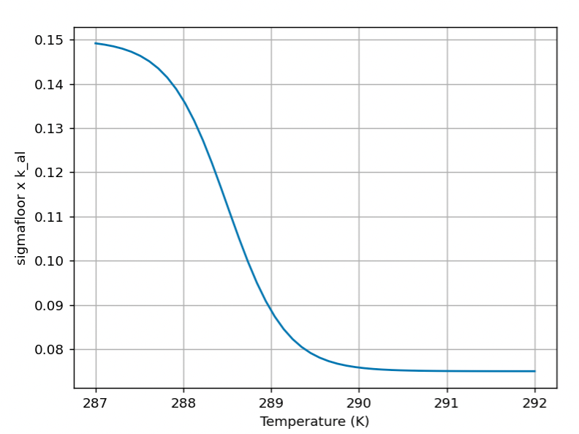
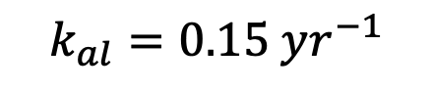
Week 5 - Scheduled and adaptive flows
$$k_{al}=0.15 yr^{−1}$$

Slide 8
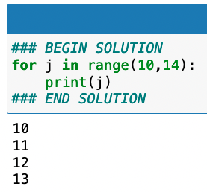
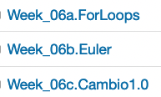
Week 6 – A carbon mass balance box model

Slide 9
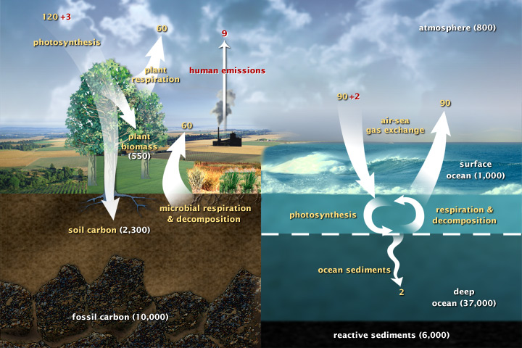
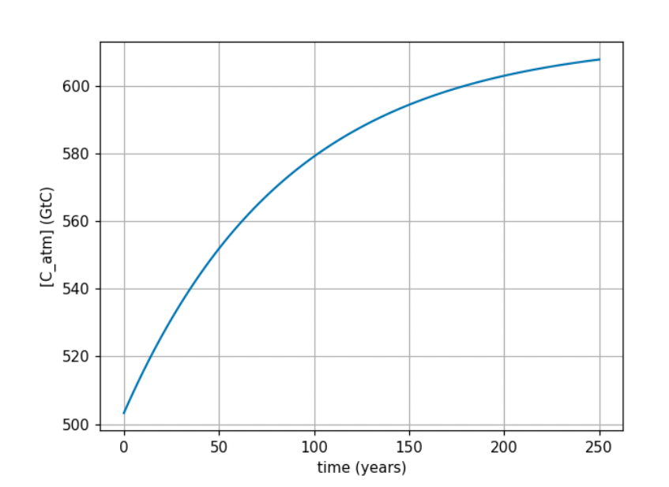
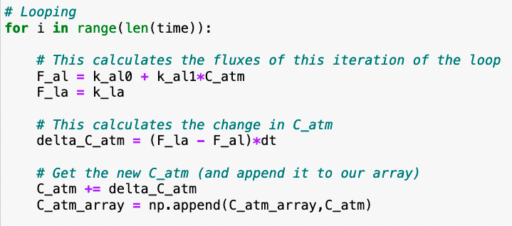
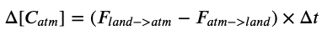
Week 6 – A carbon mass balance box model

Slide 10
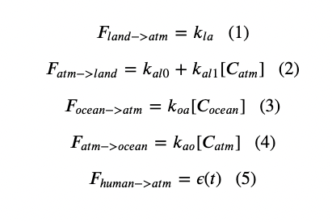
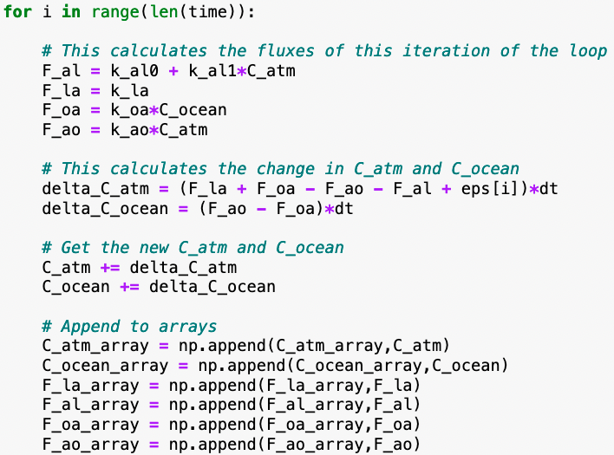
Week 6 – A carbon mass balance box model

Slide 11

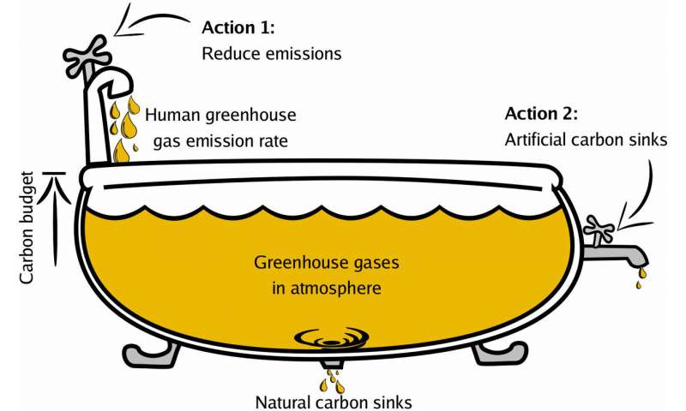
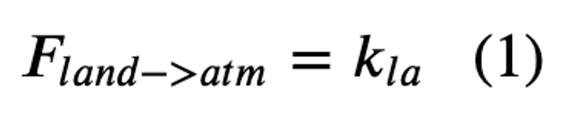
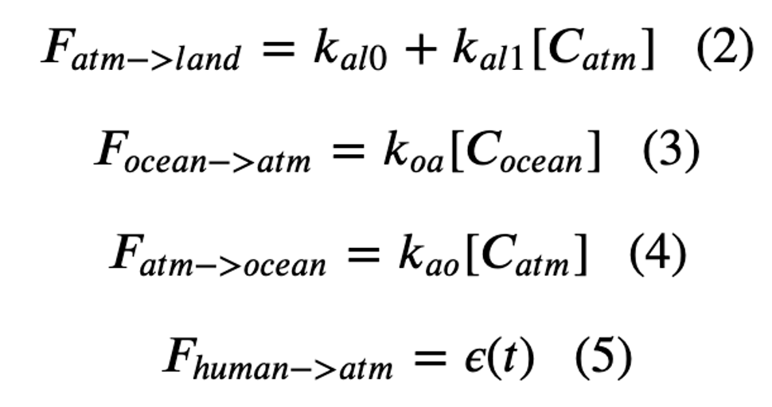
Week 6 – A carbon mass balance box model

Slide 12
Week 6 – A carbon mass balance box model

Slide 13
Week 6 – A carbon mass balance box model

Slide 14
Week 6 – A carbon mass balance box model

Slide 15
Week 6 – A carbon mass balance box model

Slide 16
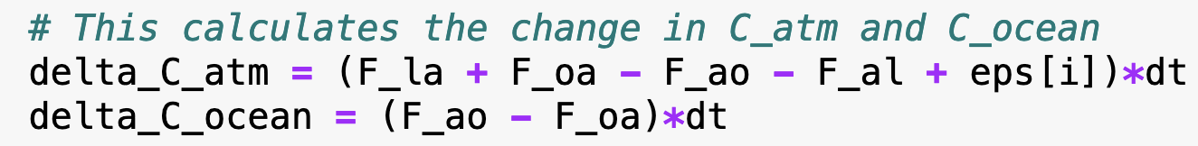
Week 6 – A carbon mass balance box model

Slide 17
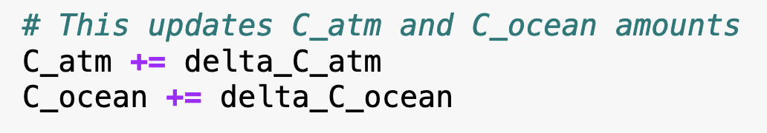
Week 6 – A carbon mass balance box model

Slide 18
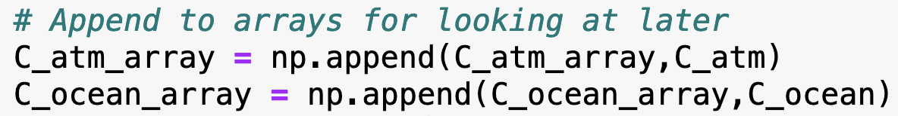
Week 6 – A carbon mass balance box model

Slide 19
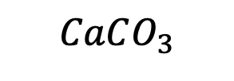
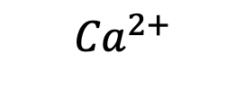
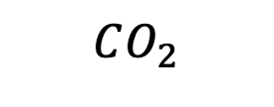
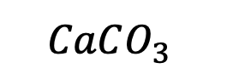
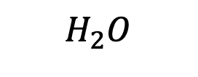
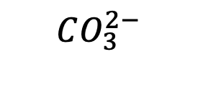
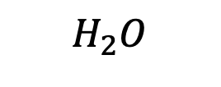
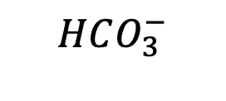

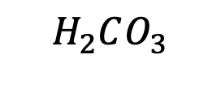
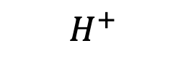
Week 8 – Ocean acidification
Air
$$CO_{2}$$
Battery acid
$$H_{2}O$$
$$H_{2}O$$
Oceans
$H_{2}CO_{3}$
$$H^{+}$$
$$H^{+}$$
$$HCO_{3}^{−}$$
$${Ca}^{2+}$$
$$CO_{3}^{2−}$$
Sea floor
$$CaCO_{3}$$
$$CaCO_{3}^{}$$
Sodium hydroxide (active ingredient in DranoTM)

Slide 20
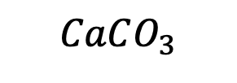
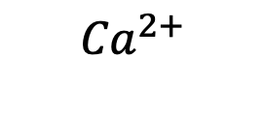
The kind of question I might ask you during our 1-on-1 regarding carbonate reactions
When calcium carbonate (chalk) at the sea floor dissolves in the water …
it amplifies ocean acidification
it counteracts ocean acidification
it has no effect on the ocean’s acidity
In nature, this process takes place …
quickly on a human time scale (~seconds)
slowly on a human time scale (centuries or more)
Air
$$CO_{2}$$
$$H_{2}O$$
$$H_{2}O$$
Oceans
$H_{2}CO_{3}$
$$H^{+}$$
$$H^{+}$$
$$HCO_{3}^{−}$$
$${Ca}^{2+}$$
$$CO_{3}^{2−}$$
Sea floor
$$CaCO_{3}$$
$$CaCO_{3}^{}$$

Slide 21
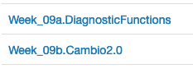
Week 9 – Carbon mass balance with diagnostics

Slide 22
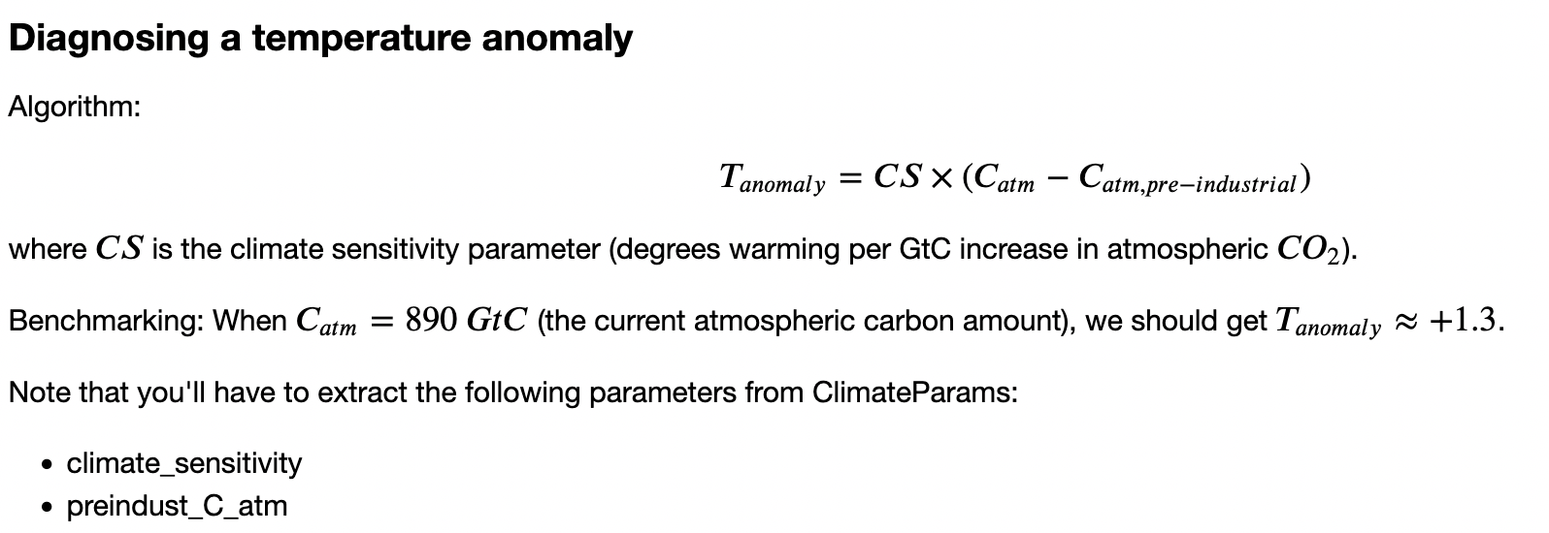
Week 9 – Carbon mass balance with diagnostics
The Blue line shows the climate sensitivity as the climate has responded to Milankovich wobbling over the last million years.
The orange line is how Earth’s temperature correlates to CO₂ since the start of the Industrial Revolution.
CS = slope of this line

Slide 23
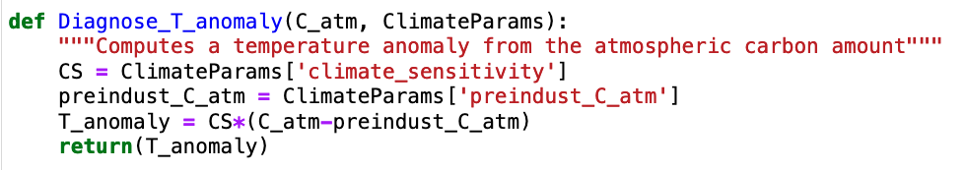
Week 9 – Carbon mass balance with diagnostics
CS = slope of this line

Slide 24
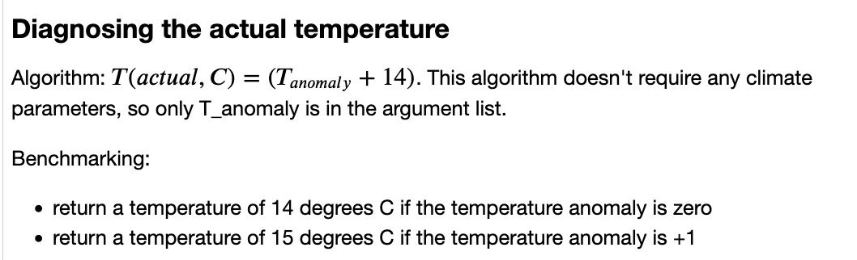
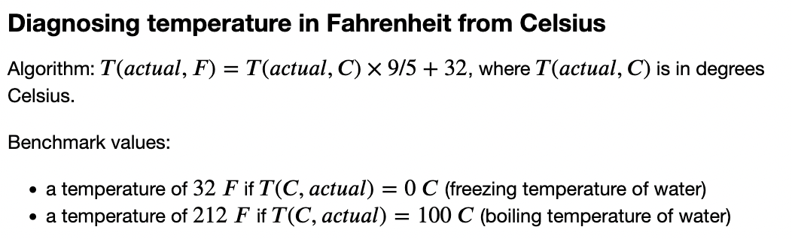





Week 9 – Carbon mass balance with diagnostics

Slide 25

Week 9 – Carbon mass balance with diagnostics

